Slide 1
Machine learning

Slide 2
Machine learning
History
Overview
NN
Classical methods
LLM
Reinforcement learning
Edge AI

Slide 3
History

Slide 4
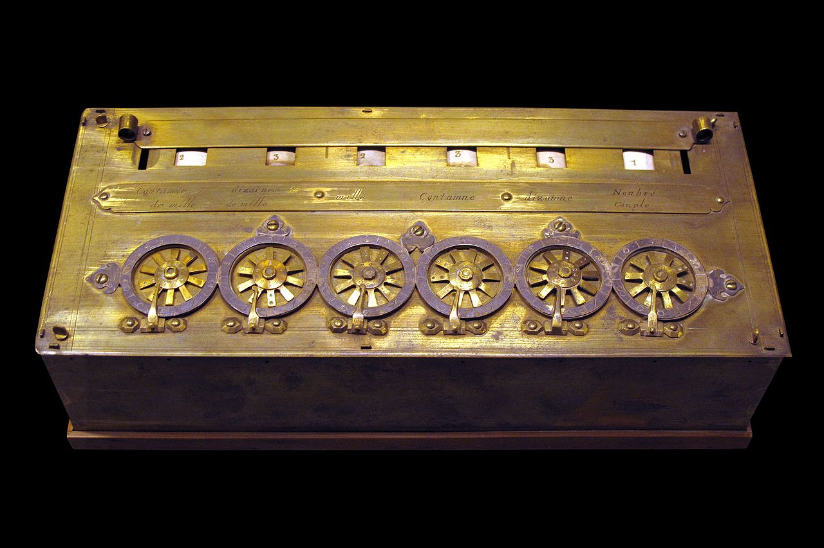
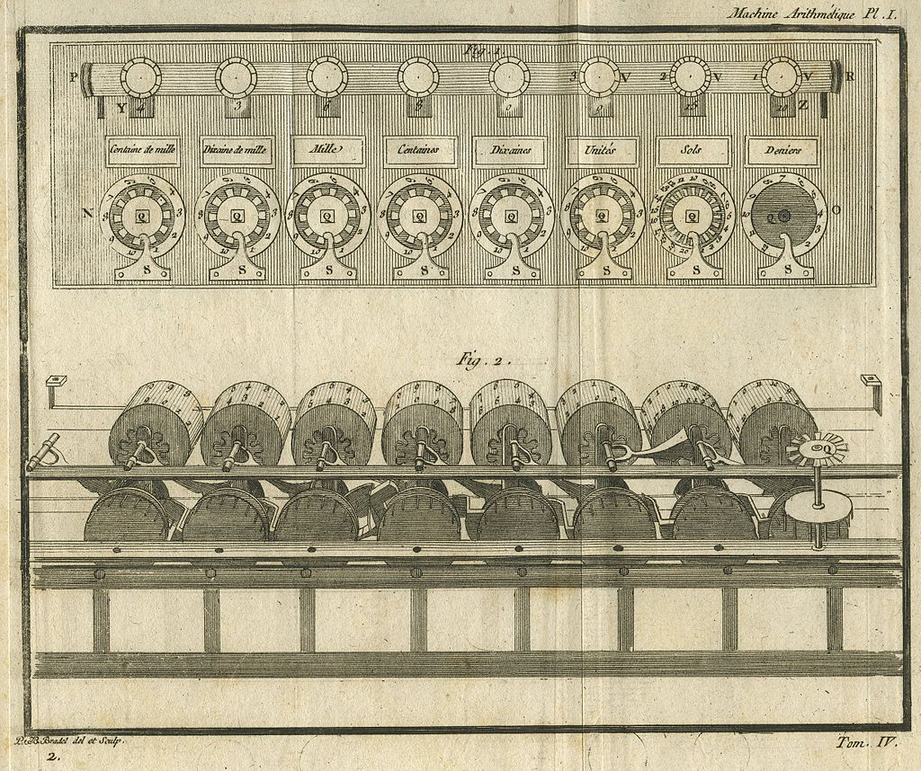
1642 – Blaise Pascal : the Pascaline

Slide 5
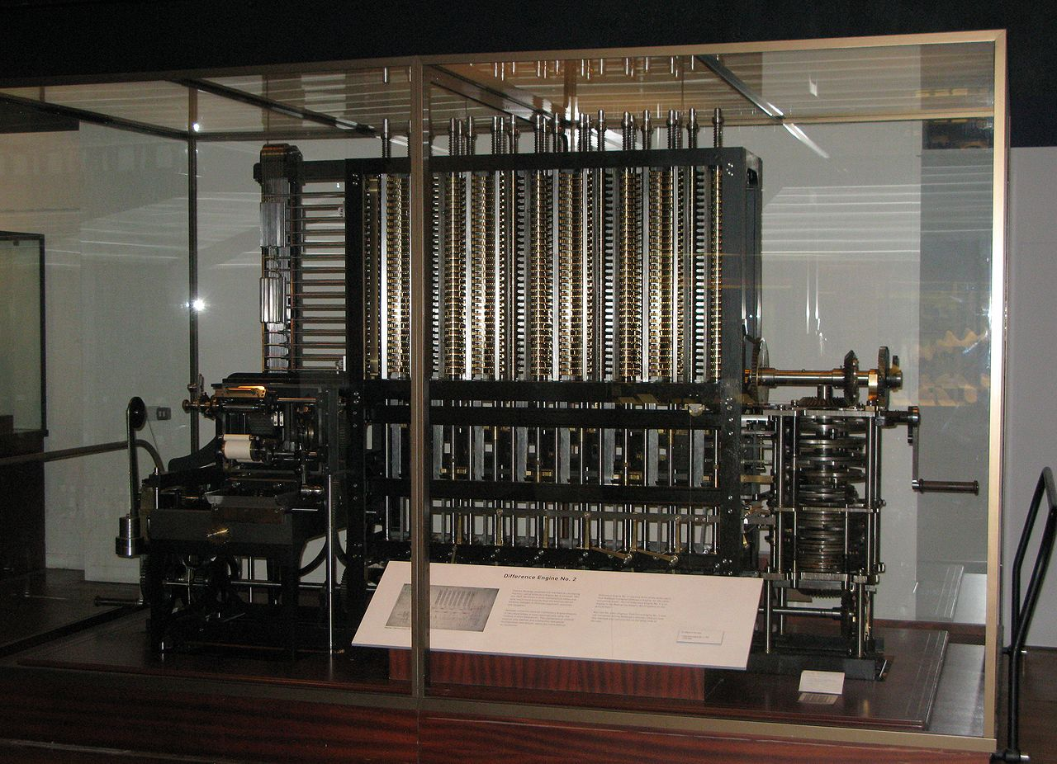
1642 – Blaise Pascal : the Pascaline
1820 – Chales Babbage : the difference engine

Slide 6
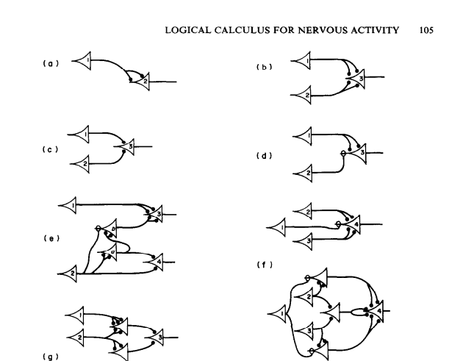
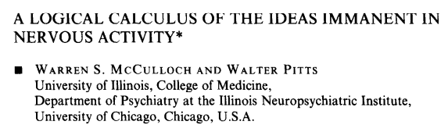
1642 – Blaise Pascal : the Pascaline
1820 – Chales Babbage : the difference engine
1943 – Warren McCulloch & Walter Pitts paper : First artificial (mathematical) neuron

Slide 7

1642 – Blaise Pascal : the Pascaline
1820 – Chales Babbage : the difference engine
1943 – Warren McCulloch & Walter Pitts paper : First artificial (mathematical neuron)
1949 – Allan Turing : The Turing test

Slide 8
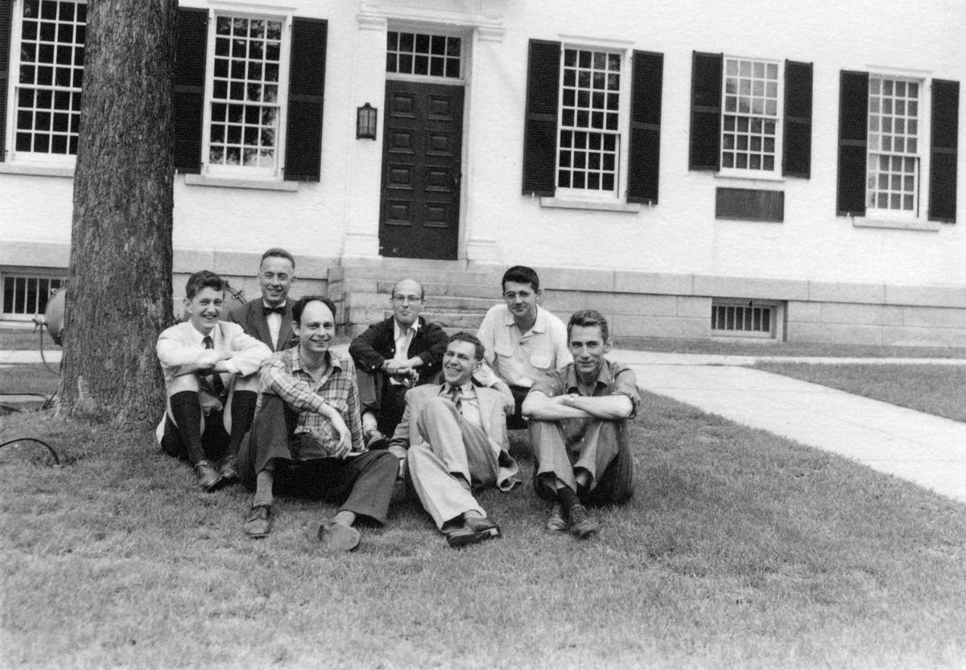
1642 – Blaise Pascal : the Pascaline
1820 – Chales Babbage : the difference engine
1943 – Warren McCulloch & Walter Pitts paper : First artificial (mathematical neuron)
1949 – Allan Turing : The Turing test
1956 – Dartmouth Conference, Marvin Minsky, Claude Shannon, ... Birth of the term “Artificial Intelligence”

Slide 9
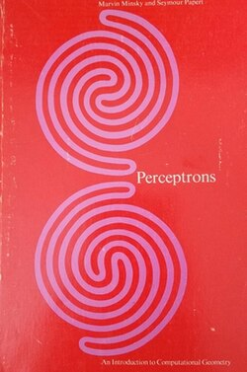
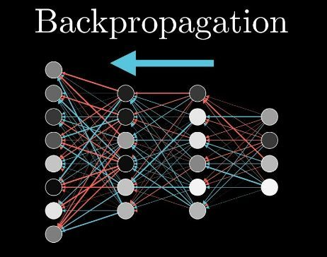
1642 – Blaise Pascal : the Pascaline
1820 – Chales Babbage : the difference engine
1943 – Warren McCulloch & Walter Pitts paper : First artificial (mathematical neuron)
1949 – Allan Turing : The Turing test
1956 – Dartmouth Conference, Marvin Minsky, Claude Shannon, ... Birth of the term “Artificial Intelligence”
1970 – First AI “winter”, but also modern backpropagation by Seppo Linnainmaa
The XOR affair

Slide 10
1642 – Blaise Pascal : the Pascaline
1820 – Chales Babbage : the difference engine
1943 – Warren McCulloch & Walter Pitts paper : First artificial (mathematical neuron)
1949 – Allan Turing : The Turing test
1956 – Dartmouth Conference, Marvin Minsky, Claude Shannon, ... Birth of the term “Artificial Intelligence”
1970 – First AI “winter”, but also modern backpropagation by Seppo Linnainmaa
1980 – Rise of expert systems (tree based)

Slide 11
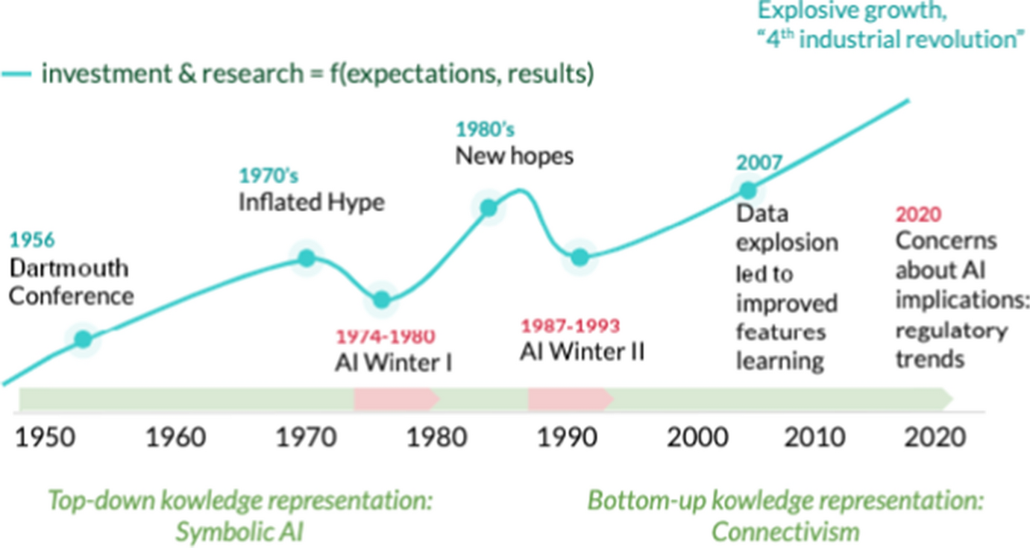
1642 – Blaise Pascal : the Pascaline
1820 – Chales Babbage : the difference engine
1943 – Warren McCulloch & Walter Pitts paper : First artificial (mathematical neuron)
1949 – Allan Turing : The Turing test
1956 – Dartmouth Conference, Marvin Minsky, Claude Shannon, ... Birth of the term “Artificial Intelligence”
1970 – First AI “winter”, but also modern backpropagation by Seppo Linnainmaa
1980 – Rise of expert systems (tree based)
1987 – Second AI “winter”

Slide 12
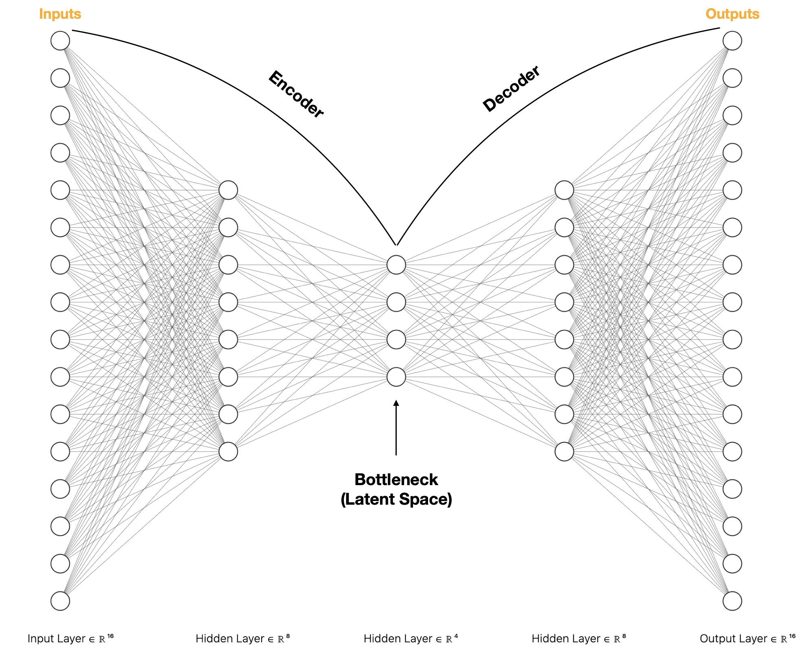
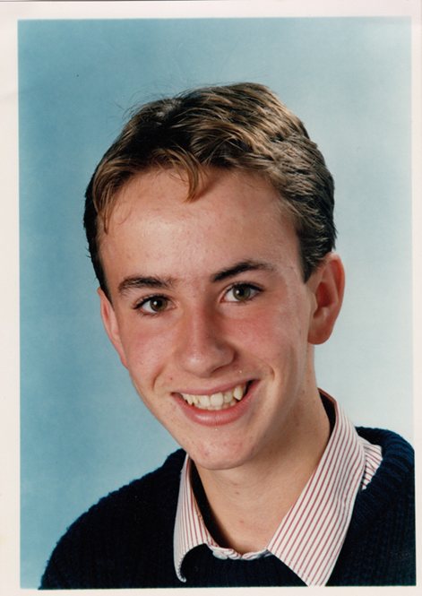
1642 – Blaise Pascal : the Pascaline
1820 – Chales Babbage : the difference engine
1943 – Warren McCulloch & Walter Pitts paper : First artificial (mathematical neuron)
1949 – Allan Turing : The Turing test
1956 – Dartmouth Conference, Marvin Minsky, Claude Shannon, ... Birth of the term “Artificial Intelligence”
1970 – First AI “winter”, but also modern backpropagation by Seppo Linnainmaa
1980 – Rise of expert systems (tree based)
1987 – Second AI “winter”
1991 – Bart Bozon AI practicum...

Slide 13
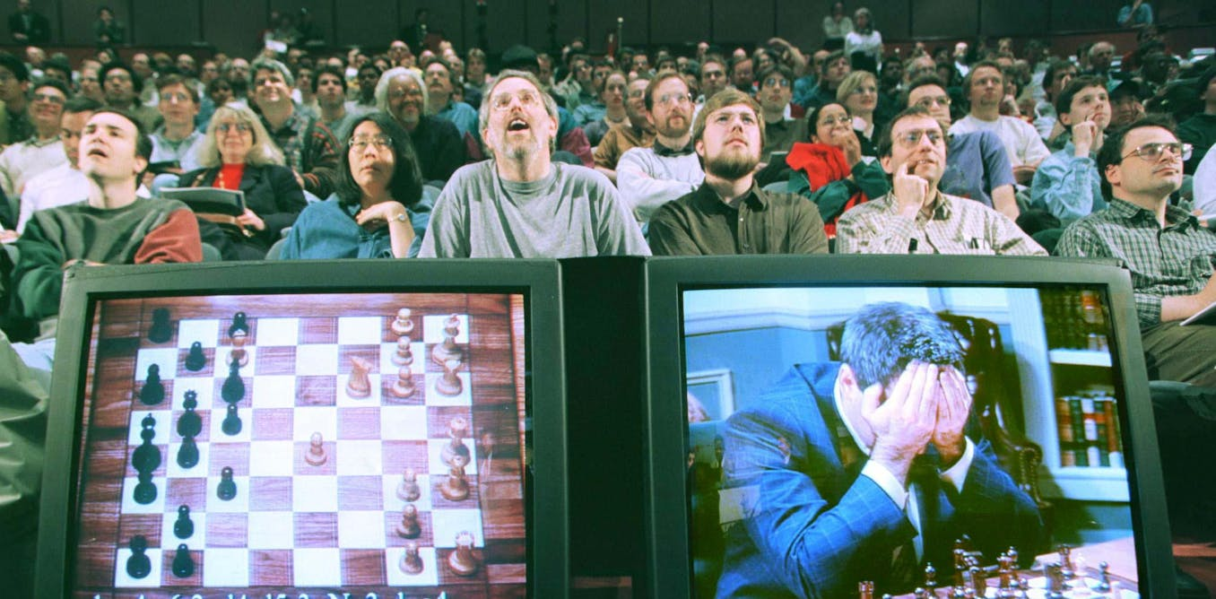
1642 – Blaise Pascal : the Pascaline
1820 – Chales Babbage : the difference engine
1943 – Warren McCulloch & Walter Pitts paper : First artificial (mathematical neuron)
1949 – Allan Turing : The Turing test
1956 – Dartmouth Conference, Marvin Minsky, Claude Shannon, ... Birth of the term “Artificial Intelligence”
1970 – First AI “winter”, but also modern backpropagation by Seppo Linnainmaa
1980 – Rise of expert systems (tree based)
1987 – Second AI “winter”
1991 – Bart Bozon AI practicum...
1997 – IBM’s Deep Blue defeats world chess champion Garry Kasparov

Slide 14

1642 – Blaise Pascal : the Pascaline
1820 – Chales Babbage : the difference engine
1943 – Warren McCulloch & Walter Pitts paper : First artificial (mathematical neuron)
1949 – Allan Turing : The Turing test
1956 – Dartmouth Conference, Marvin Minsky, Claude Shannon, ... Birth of the term “Artificial Intelligence”
1970 – First AI “winter”, but also modern backpropagation by Seppo Linnainmaa
1980 – Rise of expert systems (tree based)
1987 – Second AI “winter”
1991 – Bart Bozon AI practicum...
1997 – IBM’s Deep Blue defeats world chess champion Garry Kasparov
1995 – 2000 Internet....

Slide 15
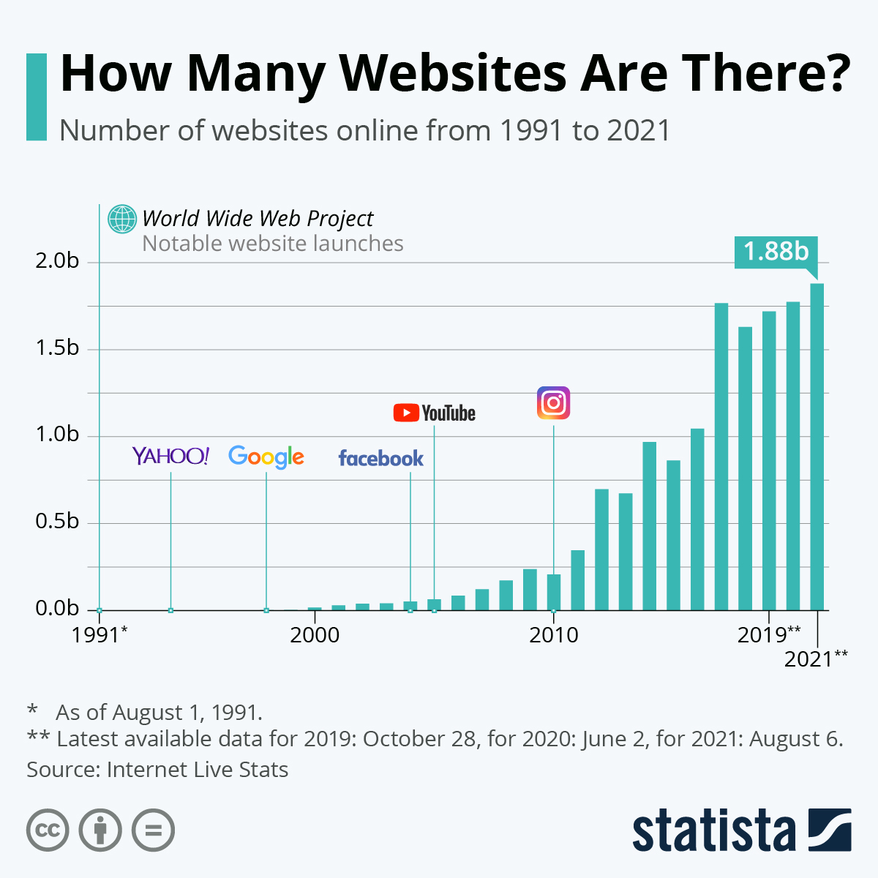
1642 – Blaise Pascal : the Pascaline
1820 – Chales Babbage : the difference engine
1943 – Warren McCulloch & Walter Pitts paper : First artificial (mathematical neuron)
1949 – Allan Turing : The Turing test
1956 – Dartmouth Conference, Marvin Minsky, Claude Shannon, ... Birth of the term “Artificial Intelligence”
1970 – First AI “winter”, but also modern backpropagation by Seppo Linnainmaa
1980 – Rise of expert systems (tree based)
1987 – Second AI “winter”
1991 – Bart Bozon AI practicum...
1997 – IBM’s Deep Blue defeats world chess champion Garry Kasparov
1995 – 2000 Internet....
2002 – Google hegemony, “big data” starts...

Slide 16
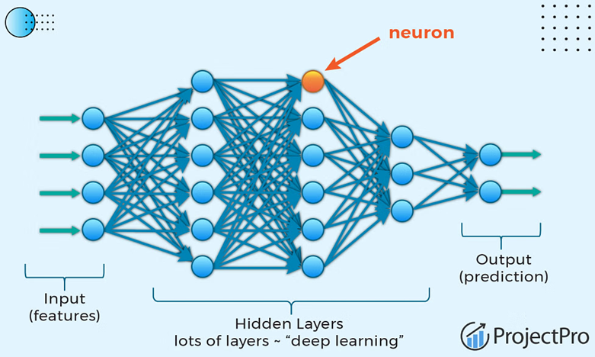
1642 – Blaise Pascal : the Pascaline
1820 – Chales Babbage : the difference engine
1943 – Warren McCulloch & Walter Pitts paper : First artificial (mathematical neuron)
1949 – Allan Turing : The Turing test
1956 – Dartmouth Conference, Marvin Minsky, Claude Shannon, ... Birth of the term “Artificial Intelligence”
1970 – First AI “winter”, but also modern backpropagation by Seppo Linnainmaa
1980 – Rise of expert systems (tree based)
1987 – Second AI “winter”
1991 – Bart Bozon AI practicum...
1997 – IBM’s Deep Blue defeats world chess champion Garry Kasparov
1995 – 2000 Internet....
2002 – Google hegemony, “big data” starts...
2005 – Deep learning (neural networks -> hidden layers)

Slide 17
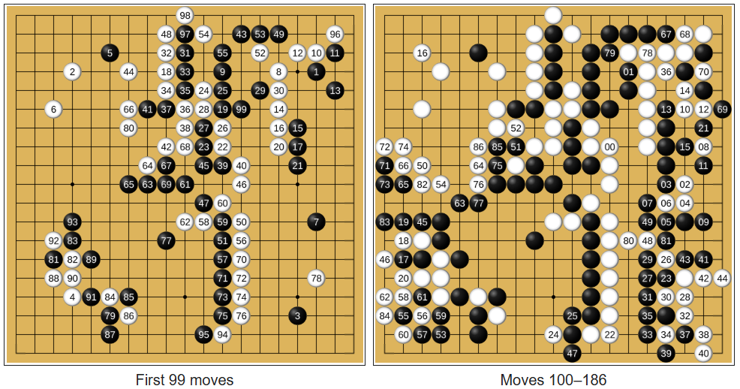
1642 – Blaise Pascal : the Pascaline
1820 – Chales Babbage : the difference engine
1943 – Warren McCulloch & Walter Pitts paper : First artificial (mathematical neuron)
1949 – Allan Turing : The Turing test
1956 – Dartmouth Conference, Marvin Minsky, Claude Shannon, ... Birth of the term “Artificial Intelligence”
1970 – First AI “winter”, but also modern backpropagation by Seppo Linnainmaa
1980 – Rise of expert systems (tree based)
1987 – Second AI “winter”
1991 – Bart Bozon AI practicum...
1997 – IBM’s Deep Blue defeats world chess champion Garry Kasparov
1995 – 2000 Internet....
2002 – Google hegemony, “big data” starts...
2005 – Deep learning (neural networks -> hidden layers)
2016 – Alpha go wins from Lee Sedol

Slide 18
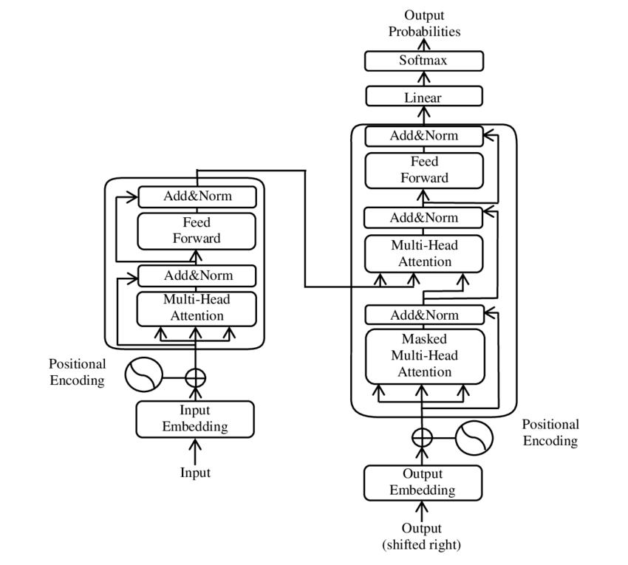
1642 – Blaise Pascal : the Pascaline
1820 – Chales Babbage : the difference engine
1943 – Warren McCulloch & Walter Pitts paper : First artificial (mathematical neuron)
1949 – Allan Turing : The Turing test
1956 – Dartmouth Conference, Marvin Minsky, Claude Shannon, ... Birth of the term “Artificial Intelligence”
1970 – First AI “winter”, but also modern backpropagation by Seppo Linnainmaa
1980 – Rise of expert systems (tree based)
1987 – Second AI “winter”
1991 – Bart Bozon AI practicum...
1997 – IBM’s Deep Blue defeats world chess champion Garry Kasparov
1995 – 2000 Internet....
2002 – Google hegemony, “big data” starts...
2005 – Deep learning (neural networks -> hidden layers)
2016 – Alpha go wins from Lee Sedol
2017 – Attention is all you need

Slide 19
History

Slide 20
Machine learning
History
Overview
NN
Classical methods
LLM
Reinforcement learning
Edge AI

Slide 21
Overview

Slide 22

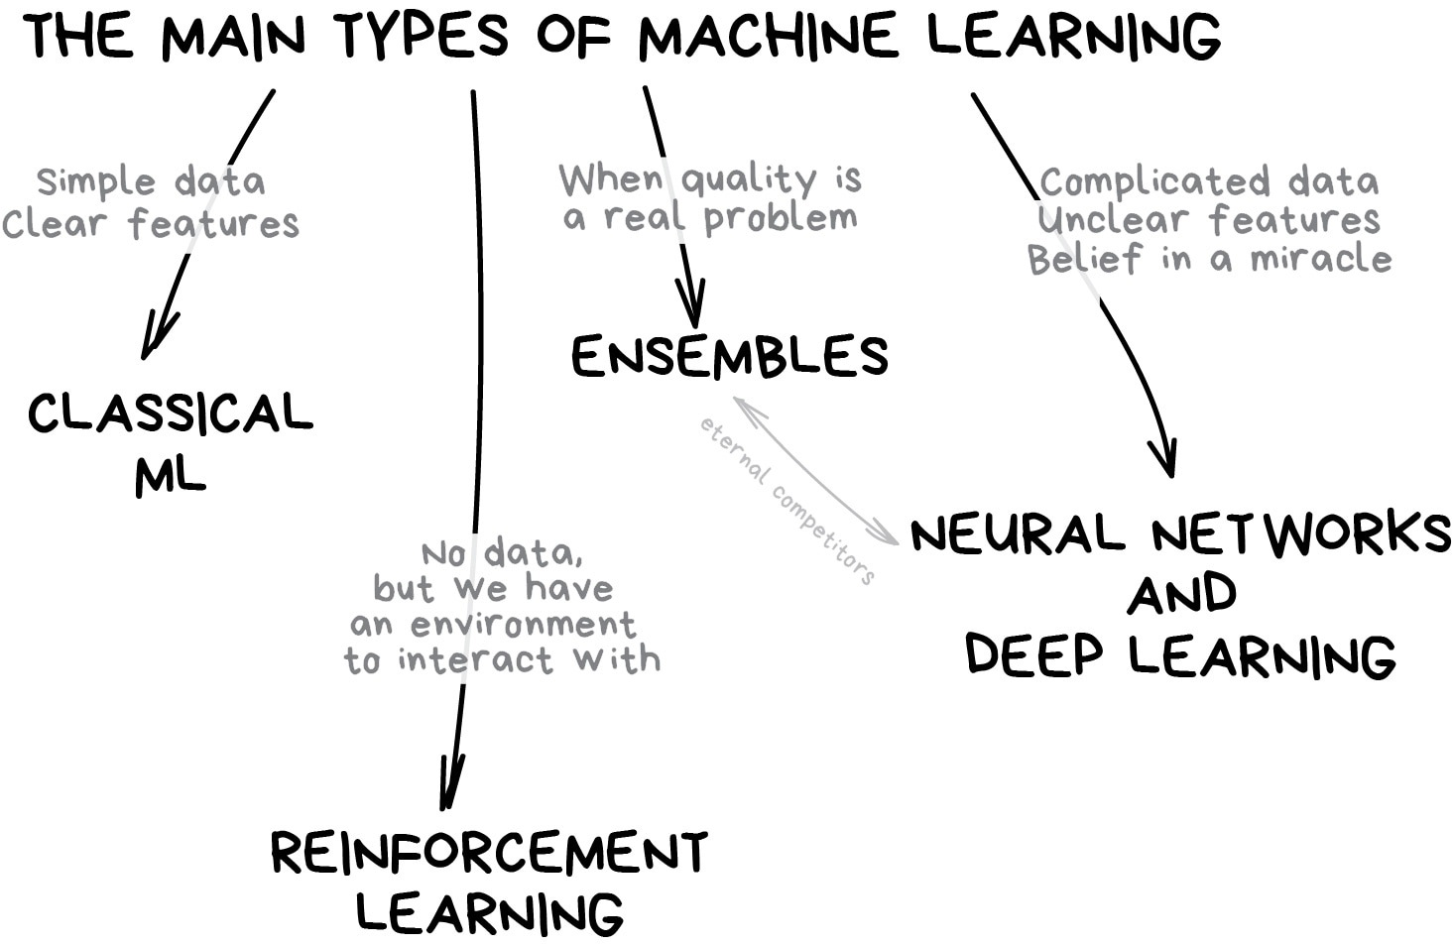
https://vas3k.com/blog/machine_learning/

Slide 23

https://vas3k.com/blog/machine_learning/

Slide 24
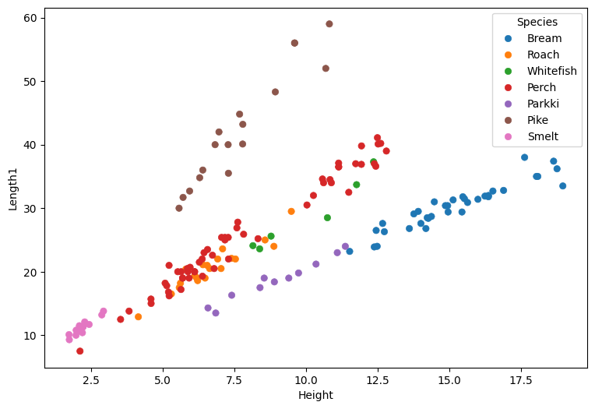
https://vas3k.com/blog/machine_learning/

Slide 25
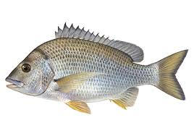
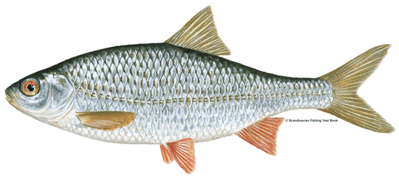
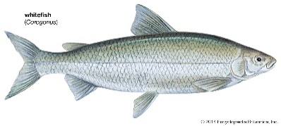
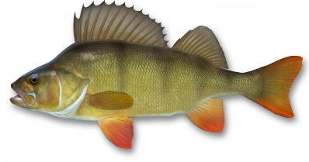

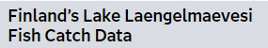
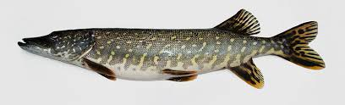
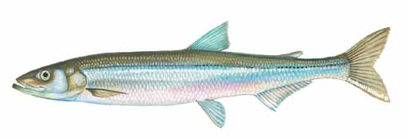
Classification
Parkki
https://documentation.sas.com/doc/en/statug/15.2/statug_sashelp_sect012.htm

Slide 26
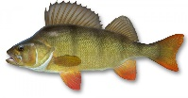

Slide 27
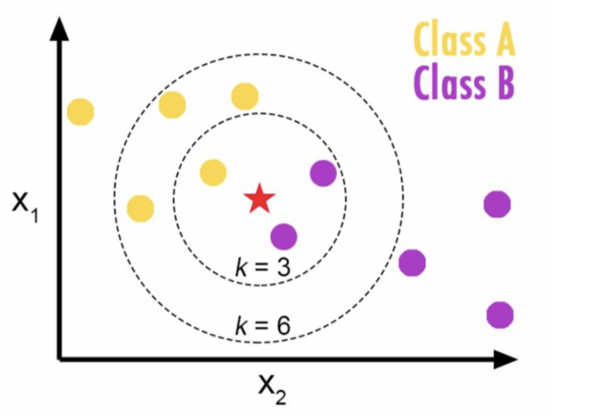
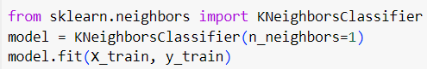
K-NN
k-Nearest Neighbors algorithm

Slide 28
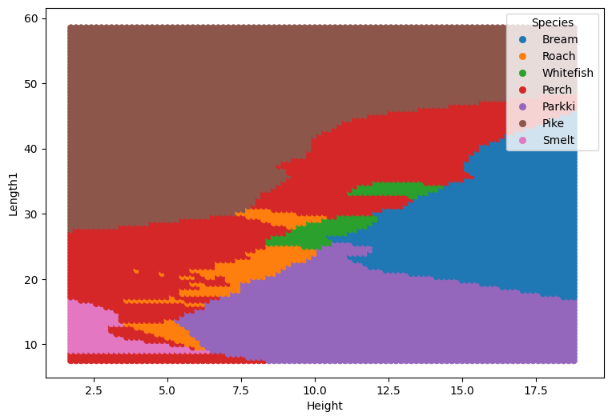
K-NN
k-Nearest Neighbors algorithm

Slide 29
Which fish is this?*
* Wanda?

Slide 32
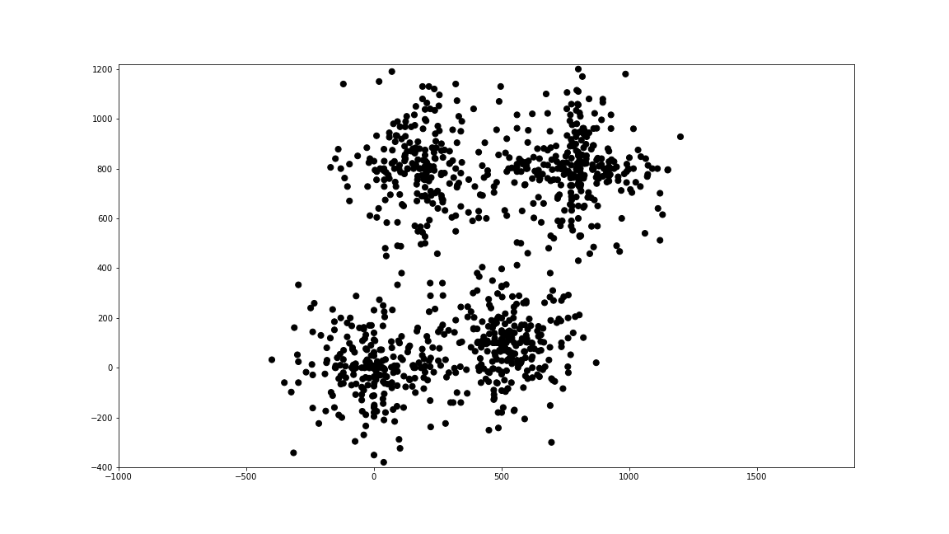

Slide 33
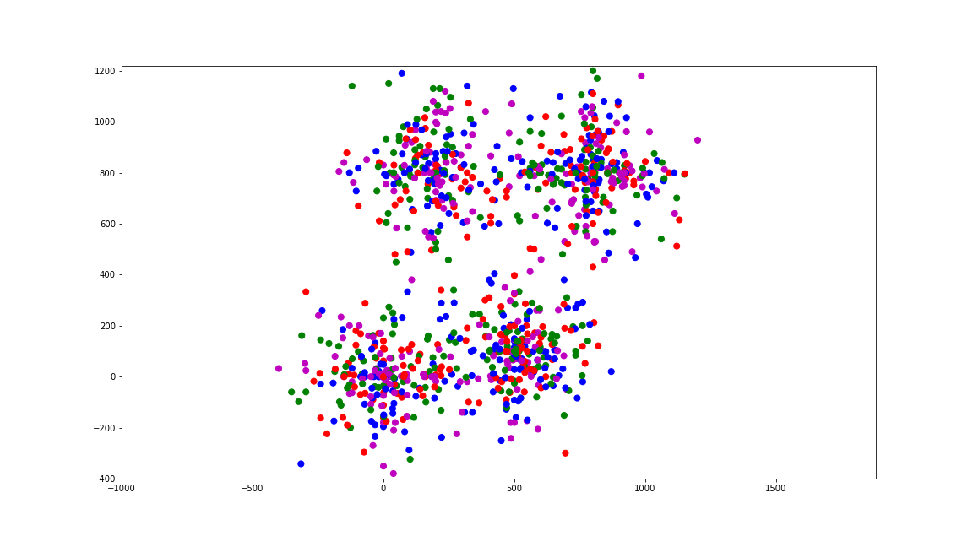

Slide 34
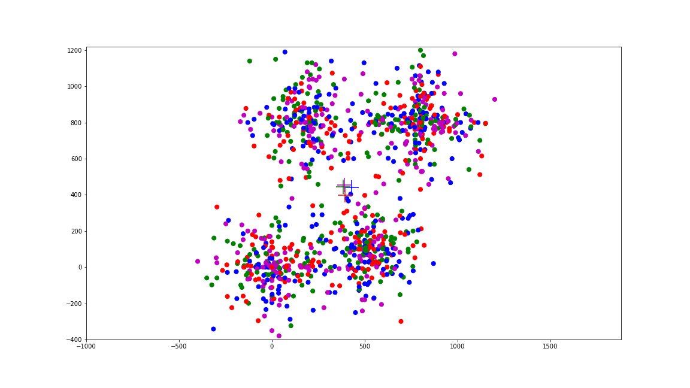

Slide 35
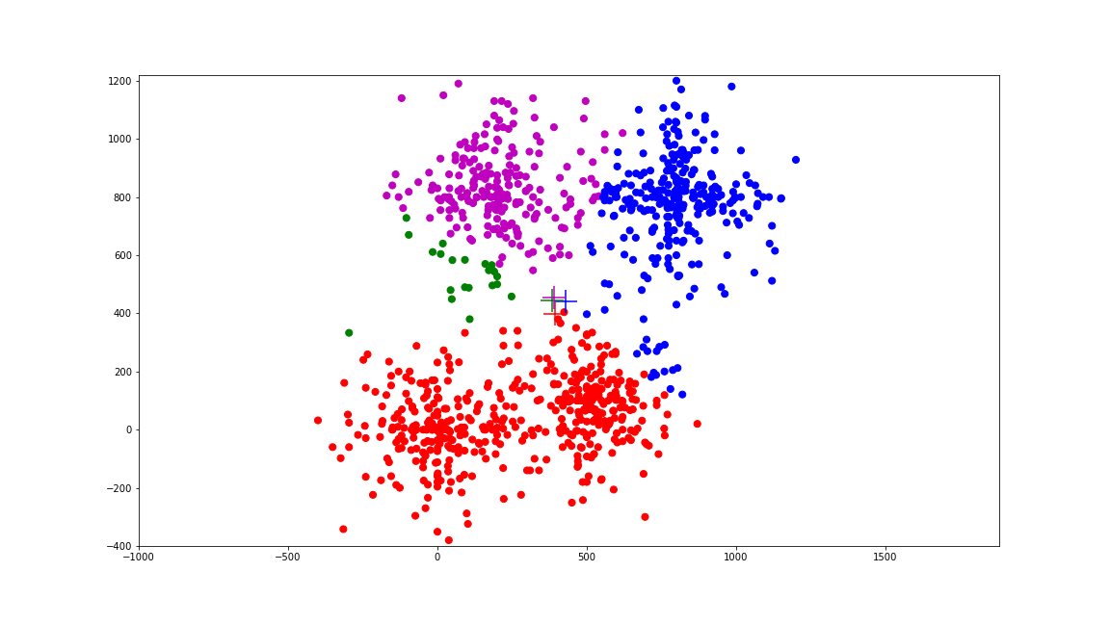

Slide 36
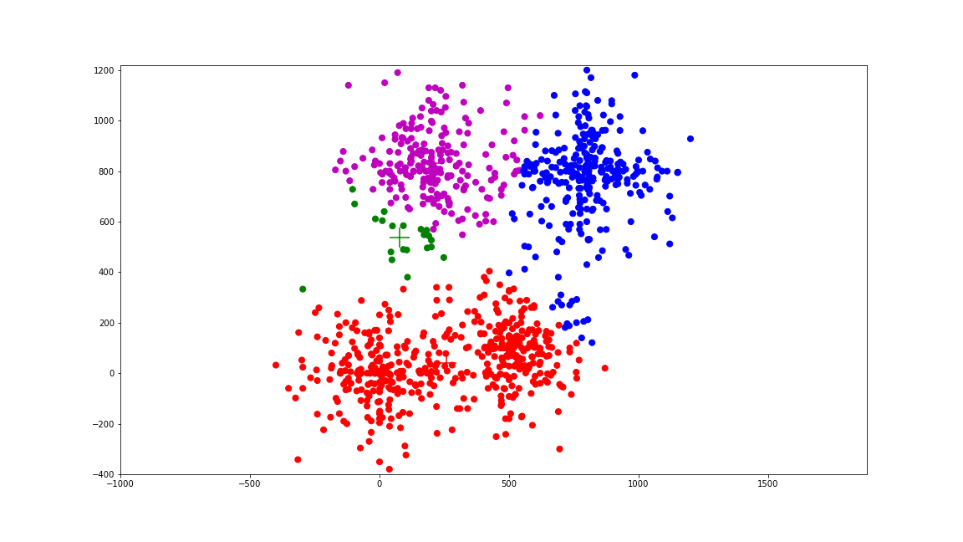

Slide 37


Slide 38
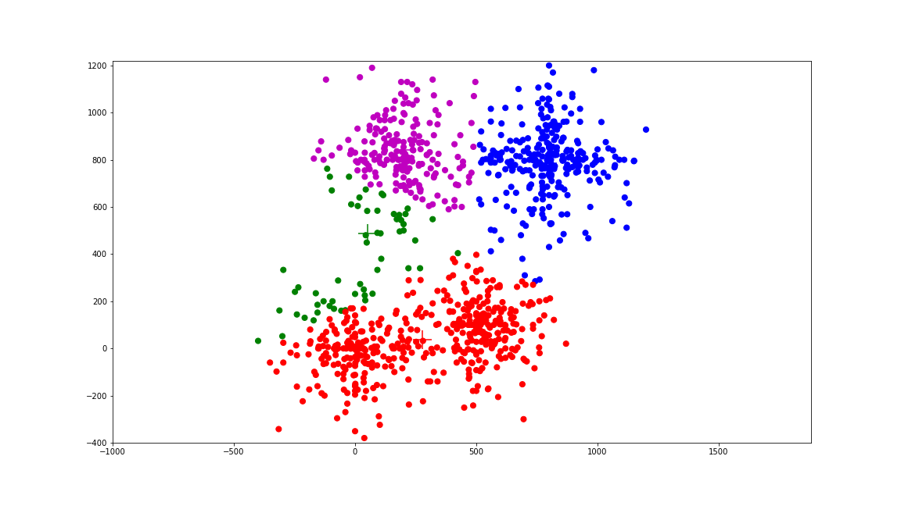

Slide 39


Slide 40
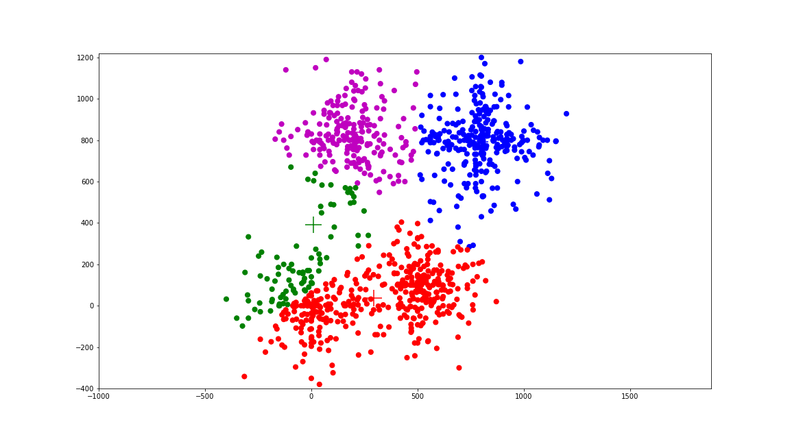

Slide 41


Slide 42


Slide 43


Slide 44
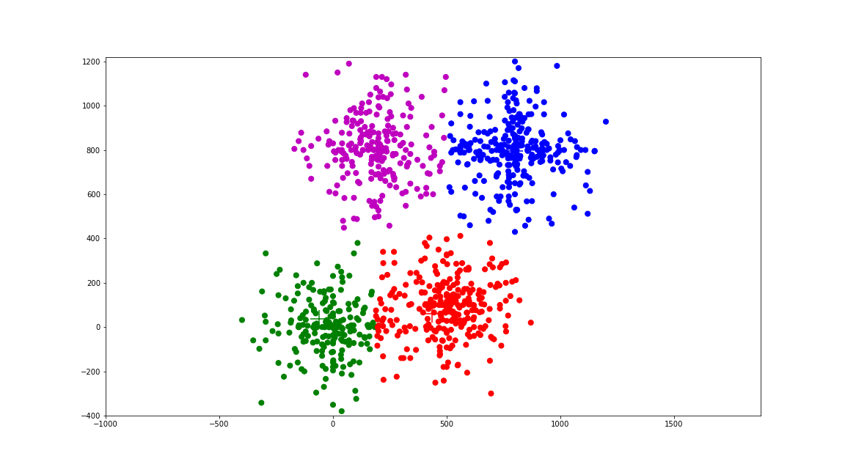

Slide 45


Slide 46


Slide 47


Slide 48
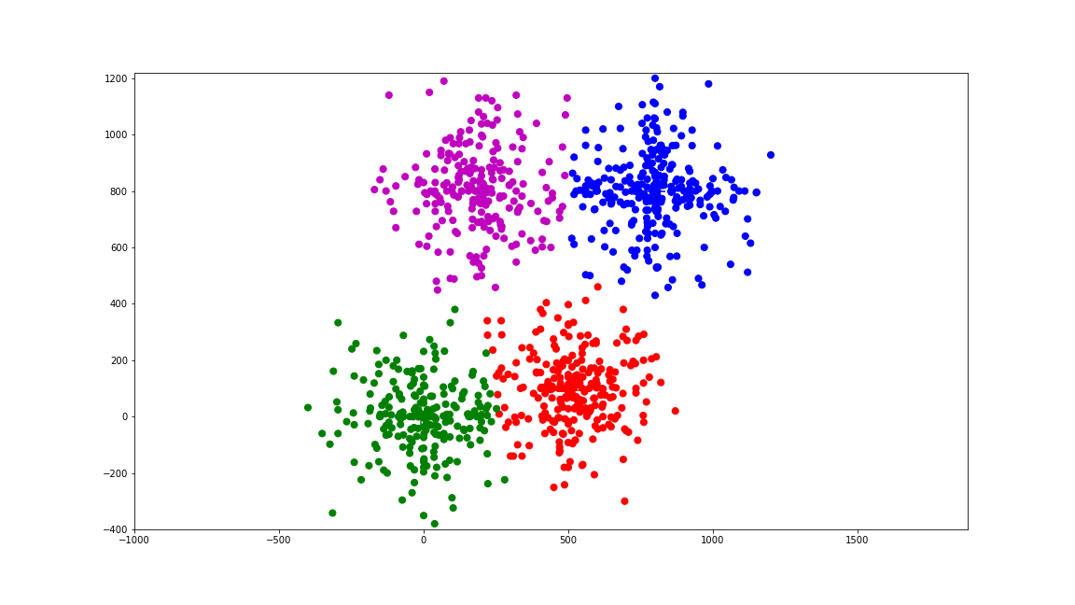

Slide 49


Slide 50


Slide 51


Slide 52
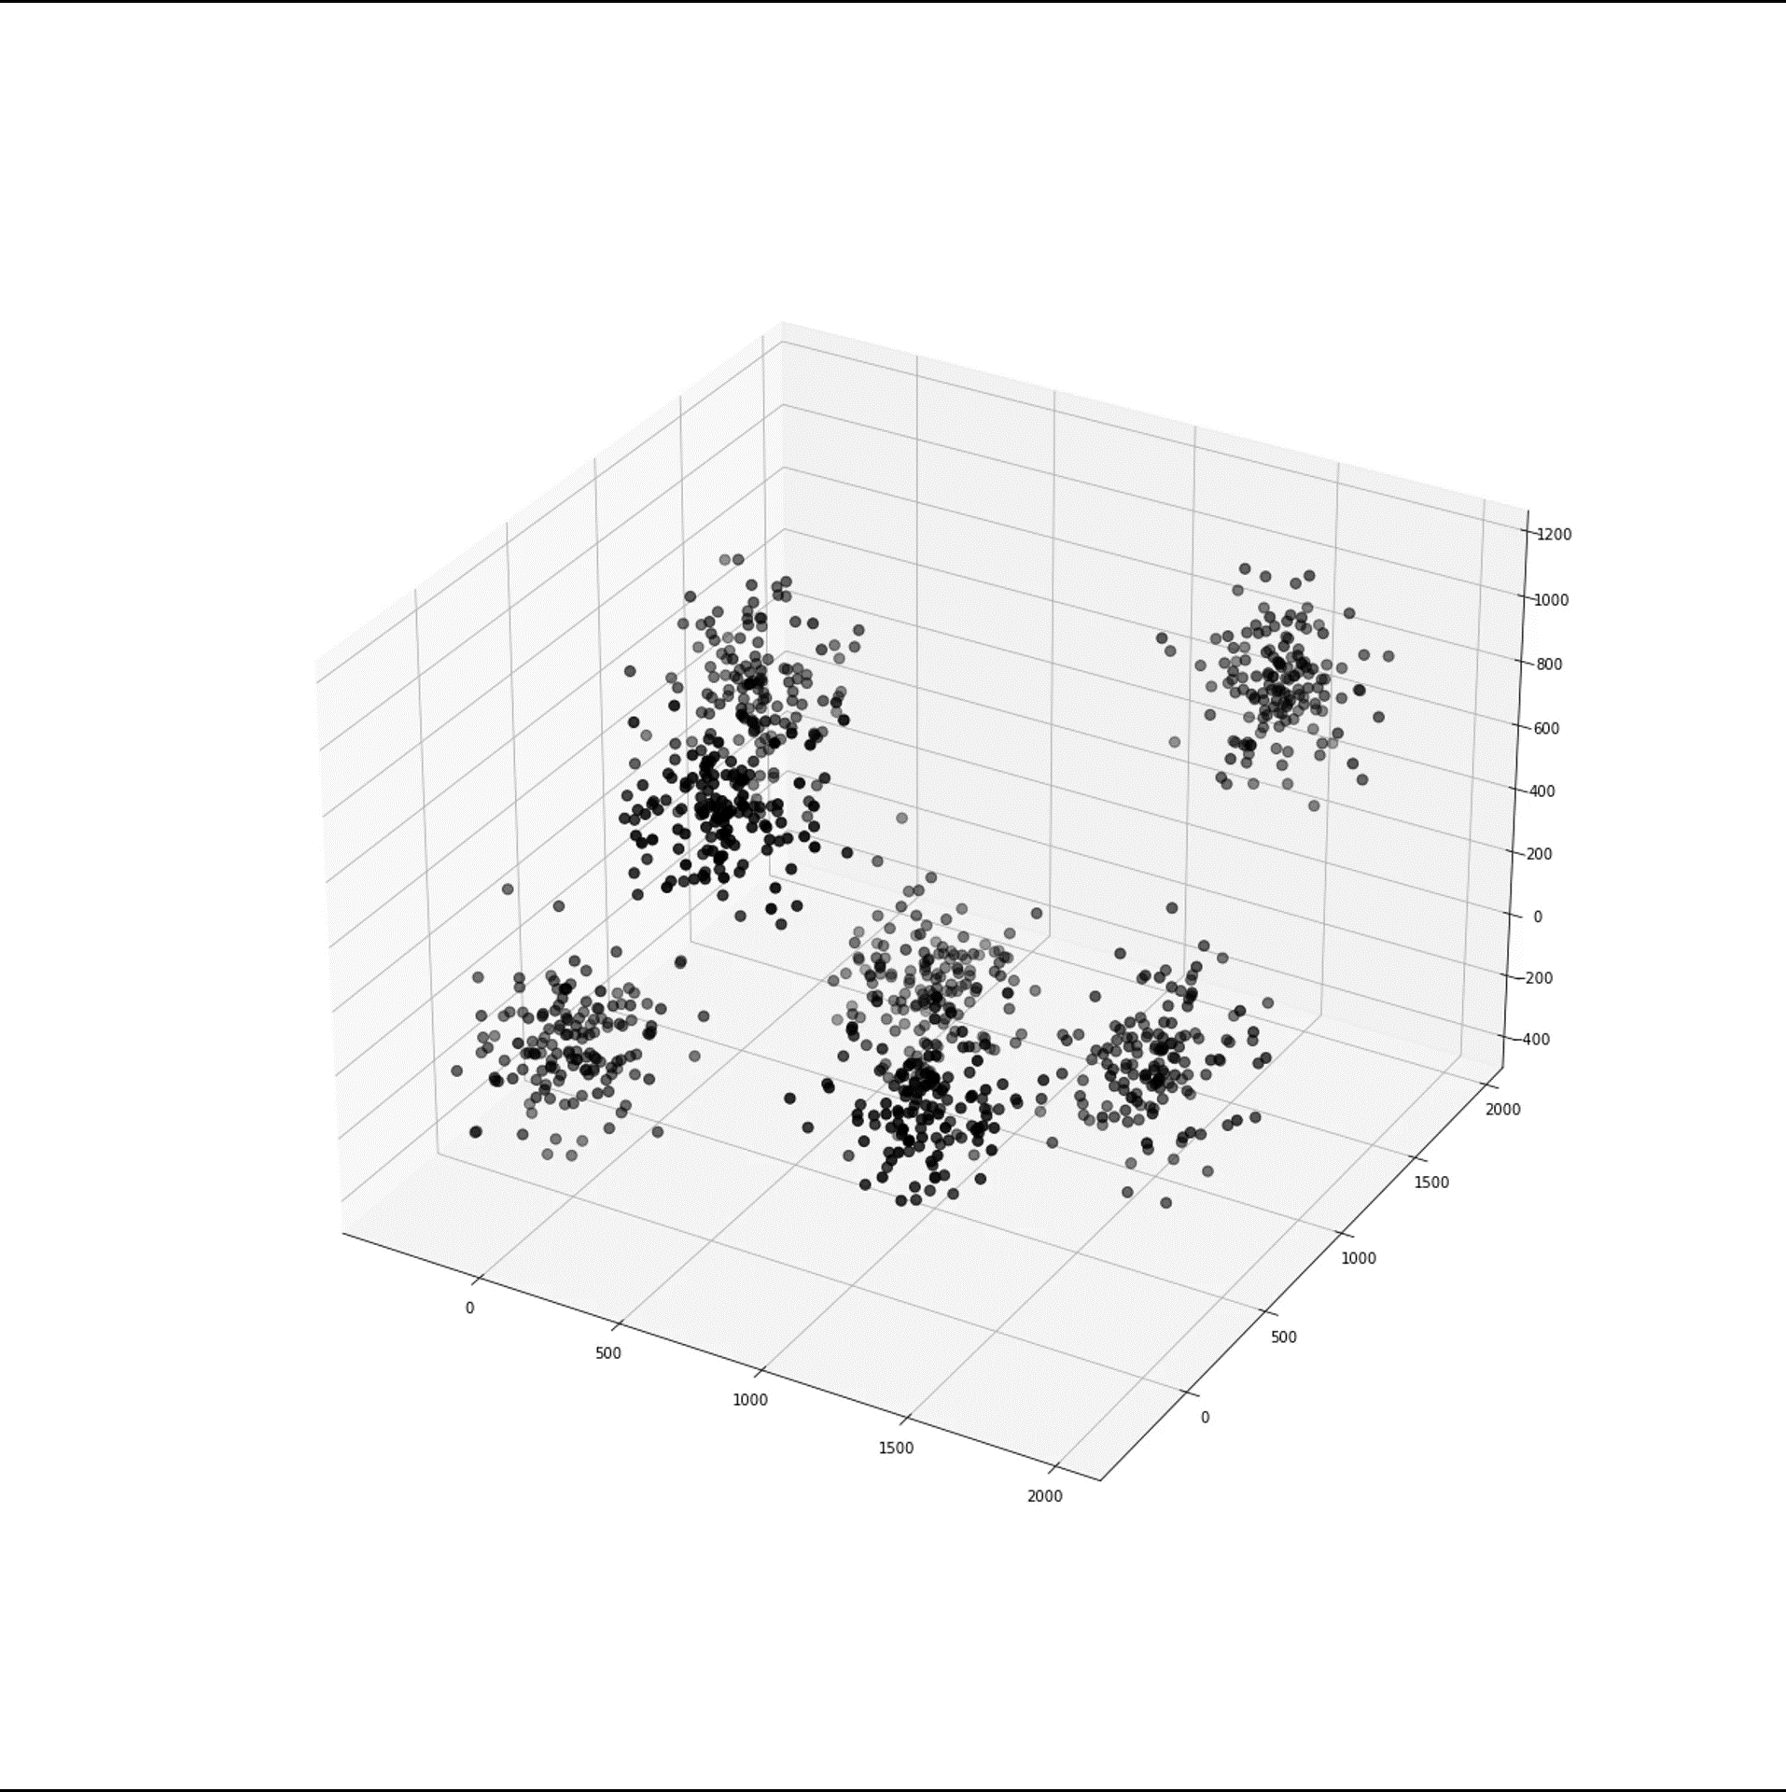

Slide 53
Classical methods

Slide 54
Machine learning
History
Overview
NN
Classical methods
LLM
Reinforcement learning
Edge AI

Slide 55
NN

Slide 56
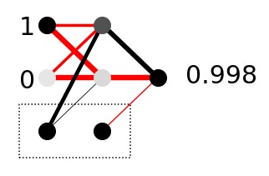
Hidden
layer
Input
layer
Output
layer
Weights
Bias

Slide 57
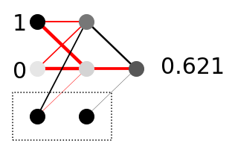
Let’s start at the back!
Which change in weights is the most useful?
Effect of 0.1 change in weights?
nodes_{hidden}
weights
nodes
0.42 x 1.24 = 0.52
0.42 x 0.1 = 0.042
0.03 x -1.87 = -0.06
0.03 x 0.1 = 0.003
1.00 x 0.16 = 0.16
1.00 x 0.1 = 0.100
Error
-0.38
0.62
How much do we need to change the weight (and which direction)?
Δ_{weight} = - learning_rate x node_{hidden} x error_{output}

Slide 58
Δ_{weight} = - learning_rate x node_{hidden} x error_{output}
error_{hidden} = derivative activation function x weight_{hidden->output} x error_{output}
Δ_{weight_input->hidden} = - learning_rate x node_{input} x error_{hidden}
More layers? Same procedure!

Slide 59

https://vas3k.com/blog/machine_learning/

Slide 60
https://vas3k.com/blog/machine_learning/

Slide 61
NN

Slide 62
Machine learning
History
Overview
NN
Classical methods
LLM
Reinforcement learning
Edge AI

Slide 63
LLM

Slide 64
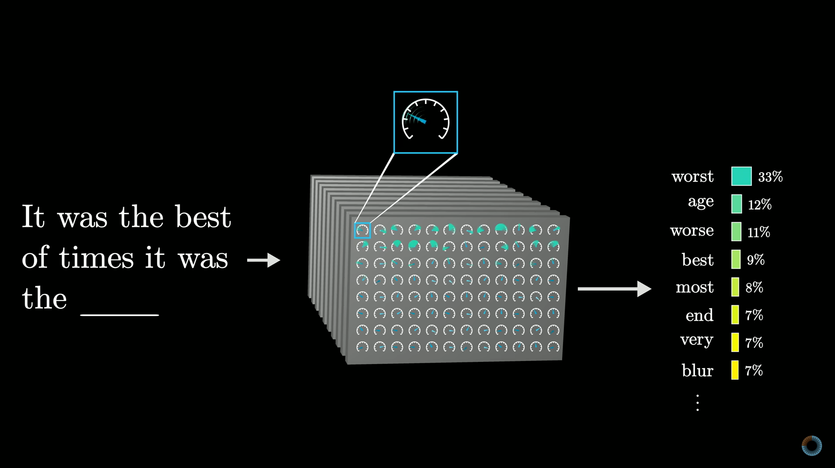

Slide 65
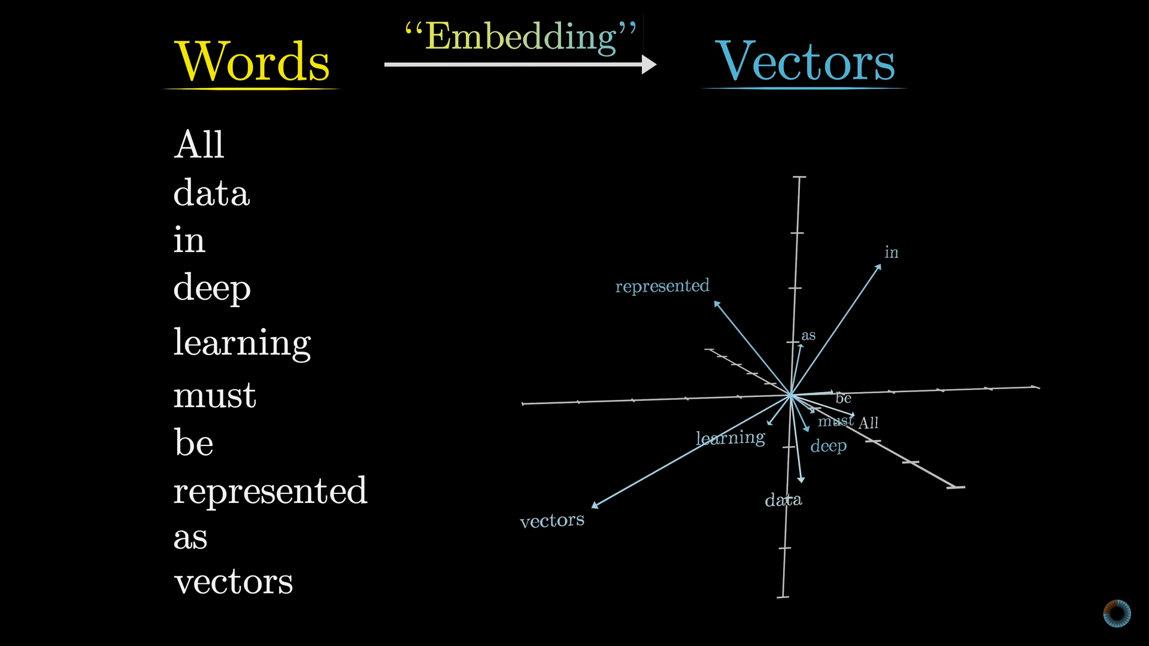

Slide 66
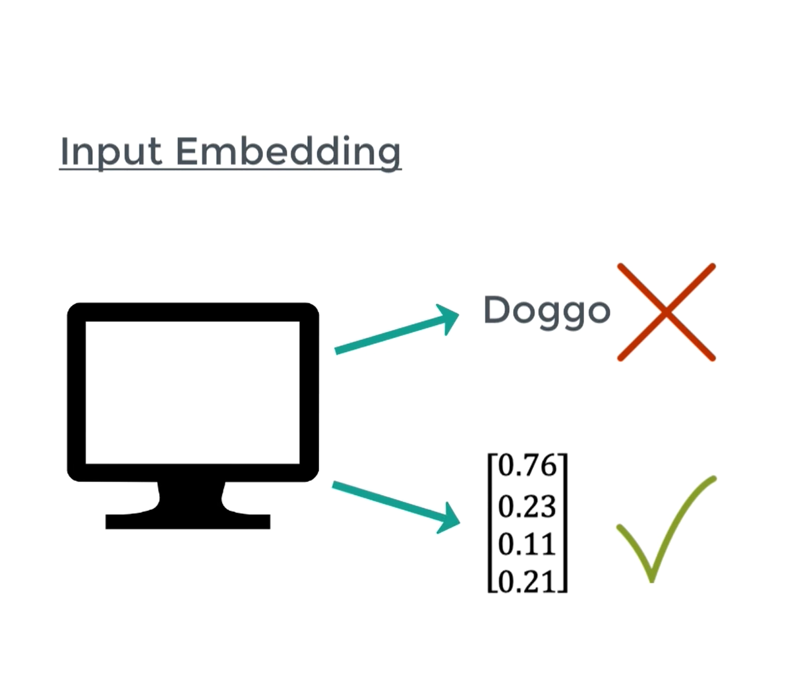

Slide 67
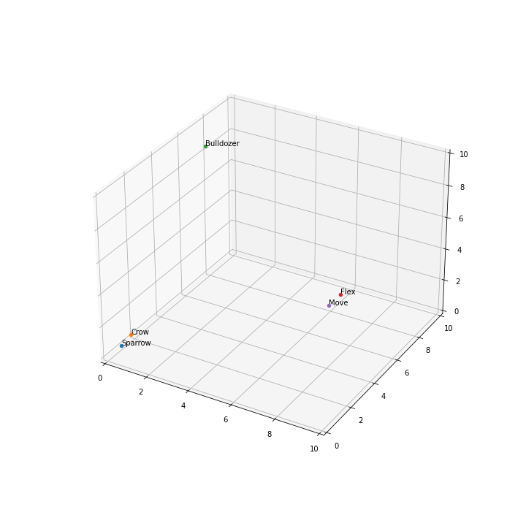

Slide 68
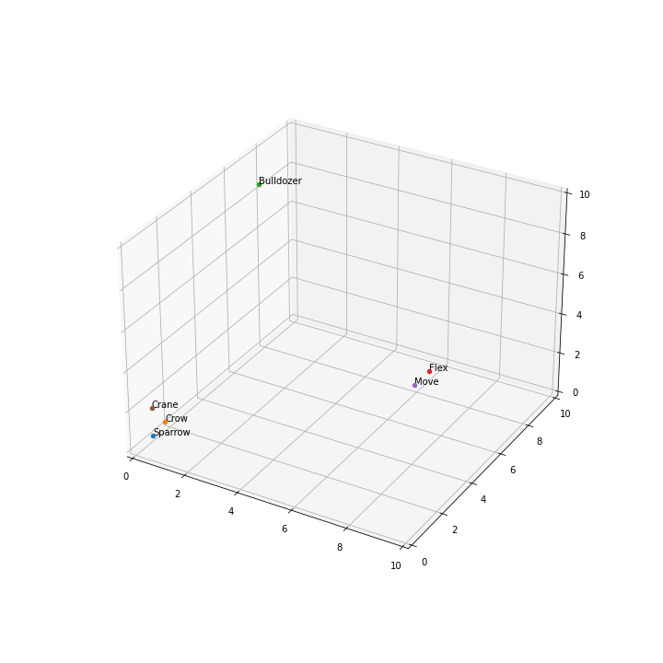
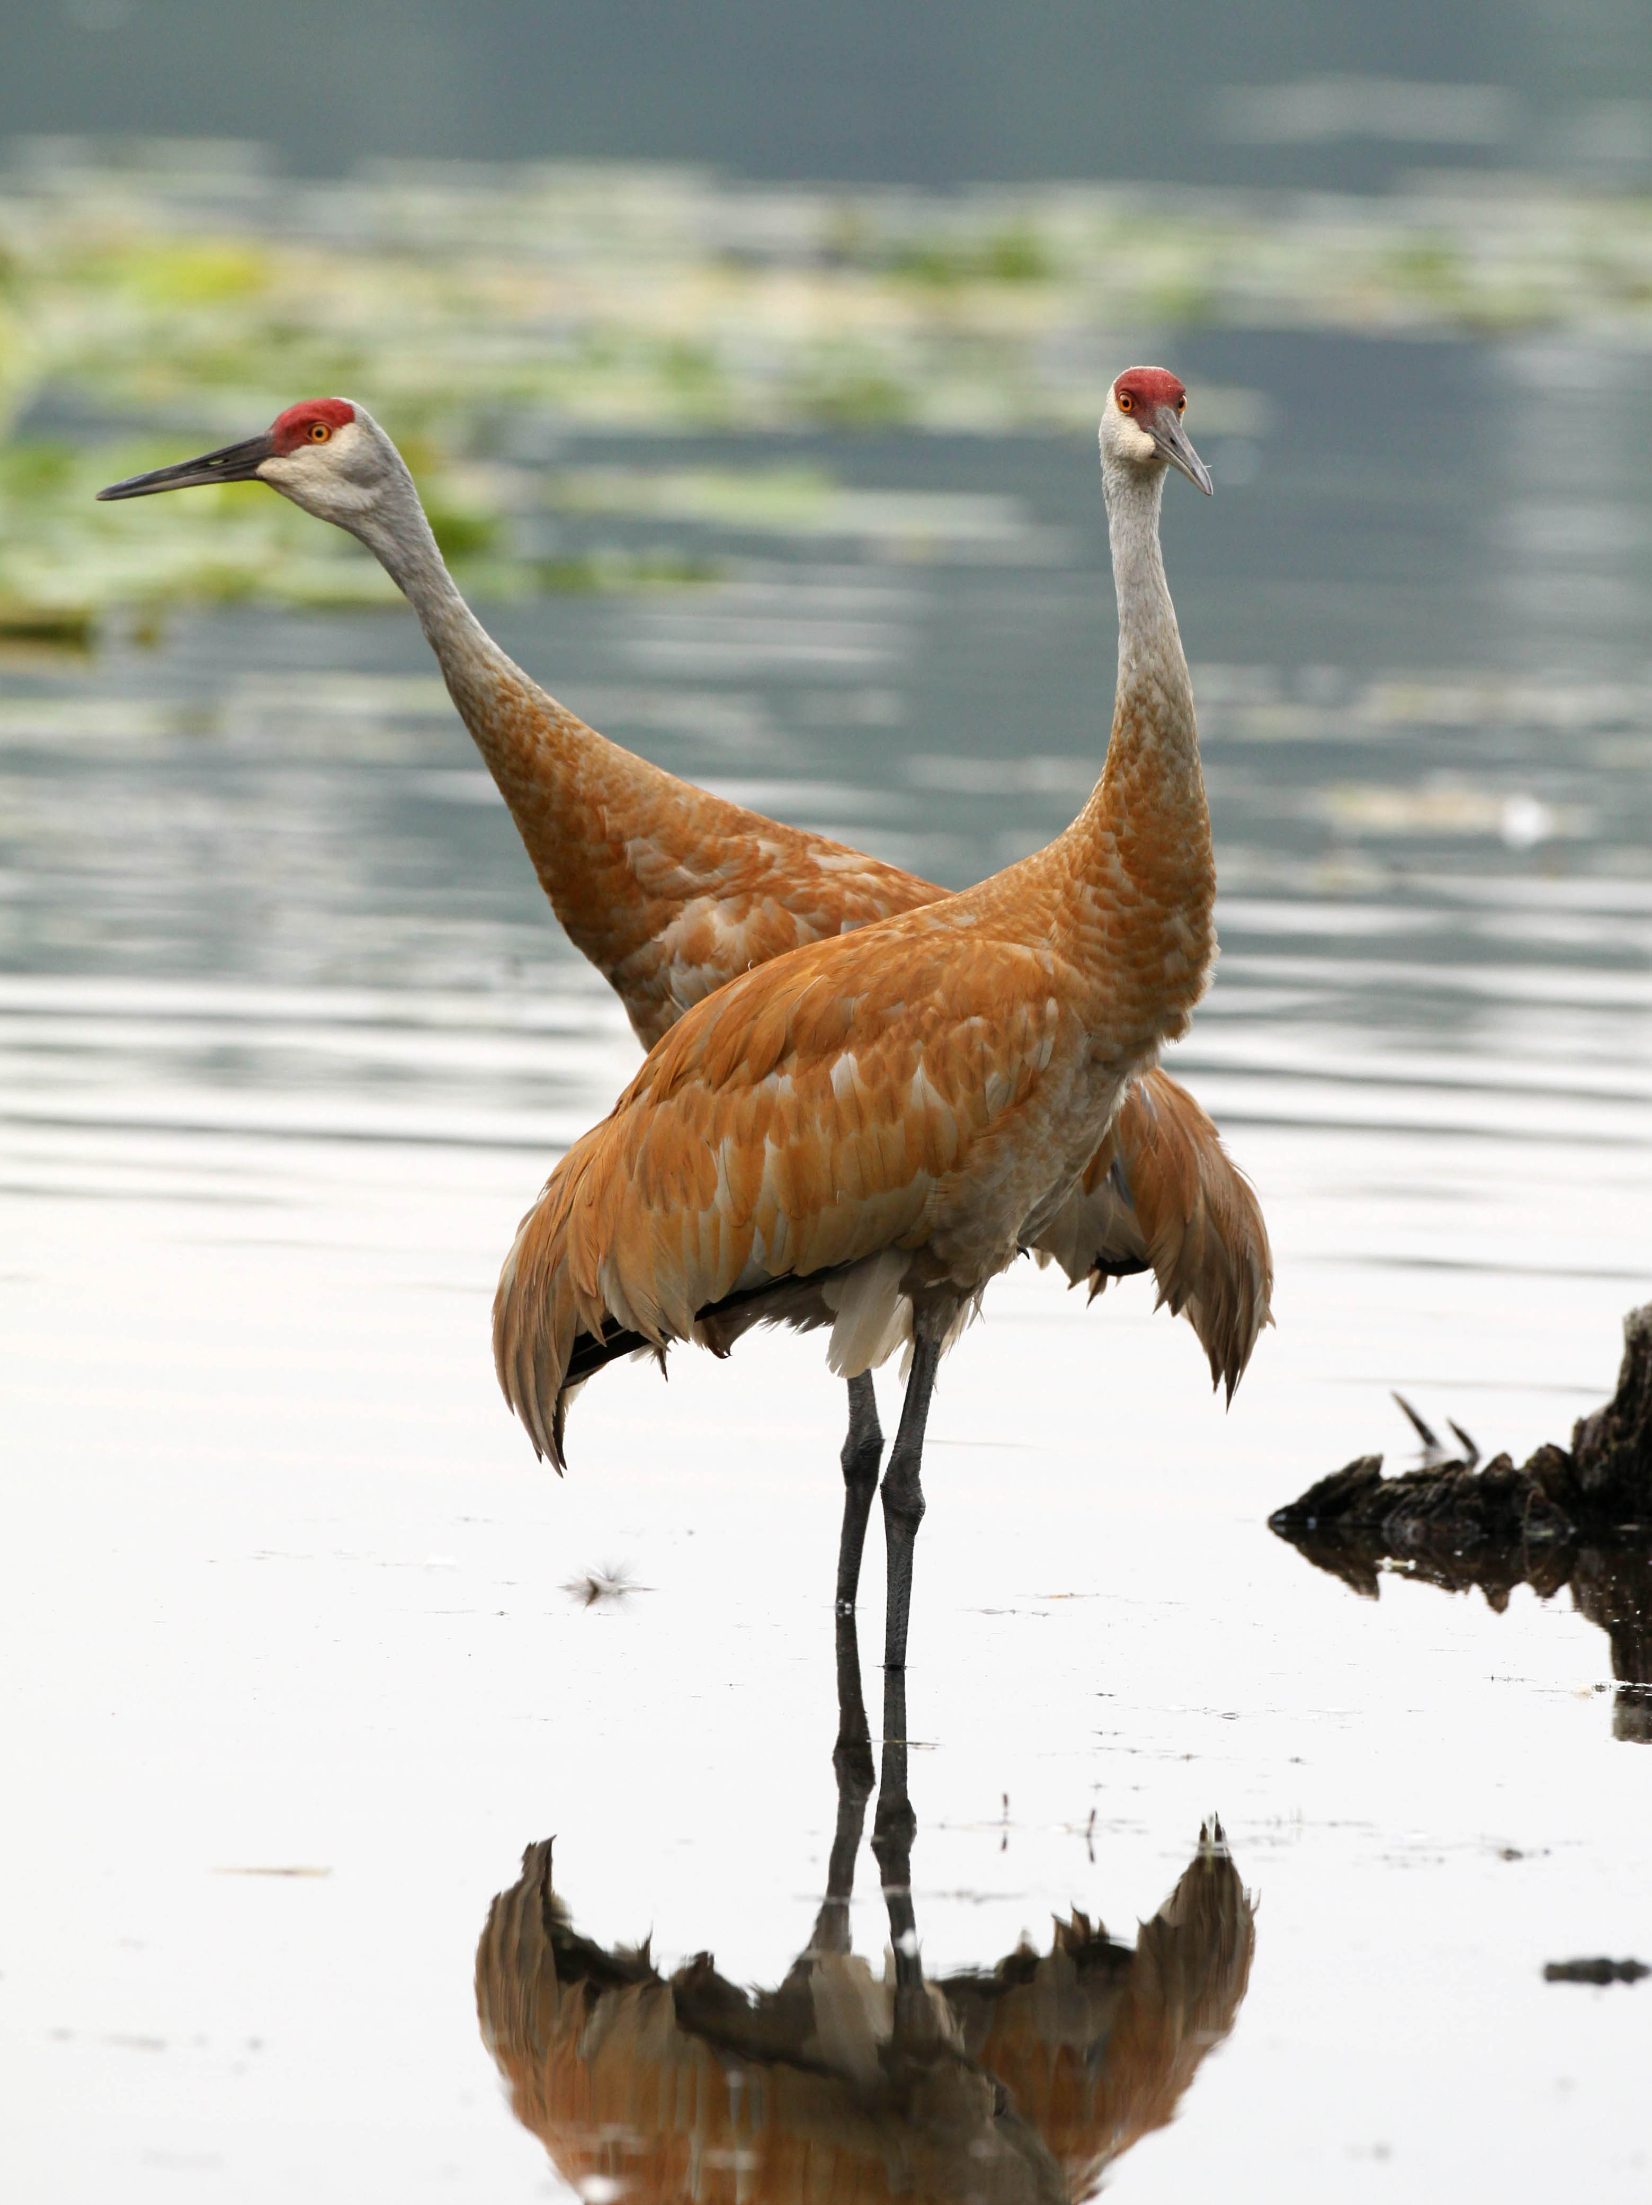
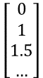
“That bird is crane.”
$$\left[\begin{aligned}0 \\ 1 \\ 1.5 \\ …\end{aligned}\right]$$
* Normally scaled between 0.0 … 1.0

Slide 69
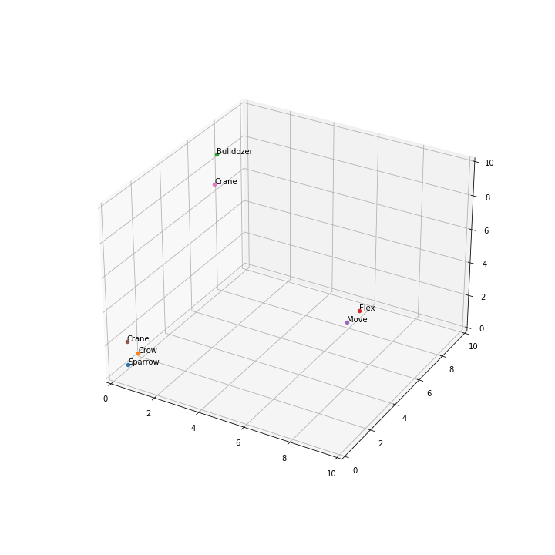

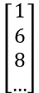
“They had to use a crane to lift a object.”
$$\left[\begin{aligned}1 \\ 6 \\ 8 \\ …\end{aligned}\right]$$

Slide 70



“She had to crane her neck to see the movie.”
$$\left[\begin{aligned}8 \\ 7 \\ 1 \\ …\end{aligned}\right]$$

Slide 71


Slide 72
LLM

Slide 73
Machine learning
History
Overview
NN
Classical methods
LLM
Reinforcement learning
Edge AI

Slide 74
Reinforcement learning

Slide 75

Reinforcement learning
We do not have the ‘labels’
We don’t know the correct output for each input…..

Slide 76

Reinforcement learning
Example: learn how to catch a ball using a video camera image

Slide 77

Reinforcement learning

Slide 78

Reinforcement learning
A technique to learn which action to take in a particular situation (state)
Useful for applications like
Games
Robotics
Traffic control
And anywhere else where decisions need to be made
Requires lots of experimentation
Either in a safe environment
Or in a simulated environment

Slide 79

Reinforcement learning
Reinforcement learning does not fall in the realm of supervised or unsupervised learning
Instead of knowing the right answers, we only get an indication (a “reward”) of how well we are doing

Slide 80


Reinforcement learning – The set-up
Reinforcement learning always has three components
A controller (the agent): It decides on an action $u$
A process: given a state $x$ and an action $u$ it deter- mines a new state $x$
A reward function: based on $x$ and $u$ it gives a reward $r$ to the controller
The main question: how do we set up the controller such that we maximize the sum of all the future rewards $r_{1}+r_{2}+r_{3}+ …$ ?
The solution is a “policy”

Slide 81
Reinforcement learning
Reinforcement learning is notoriously difficult
Training instabilities, very sensitive to choice hyperparameters and random seeds…
‘Supervised learning wants to work, Reinforcement learning must be forced to work’, A Karpathy

Slide 82


Reinforcement learning – the reward problem
Reward
Is this a good move????
Depends on all the next moves!!!!
And there are almost infinite next moves!!!!
Also true!

Slide 83
Reinforcement learning
We are just scratching the surface…. We could go on for several weeks…..

Slide 84
Reinforcement learning
We do not have the ‘labels’
We don’t know the correct output for each input…..
Getting the labels depends on the system/process we want to control (e.g. tic tac toe is easier than chess or go)
The labels don’t stay fixed, as the control system gets better, the labels change….
It is tricky….. but very promising field for engineering…..
It works a lot like a baby growing up (with the same ‘slow ‘speed). It tries and learns, the rewards can be painful….

Slide 85
Reinforcement learning

Slide 86
Machine learning
History
Overview
NN
Classical methods
LLM
Reinforcement learning
Edge AI

Slide 87
Edge AI

Slide 88


Slide 89

https://www.imagimob.com/blog/edge-computing-needs-edge-ai

Slide 90


Slide 91



Slide 92


Slide 93
Example
Predict Throat cancer

Slide 94









Vowel recognition
FFT
n=256
$$∆_{f}=31.5 Hz$$
256
128
128
a e o i u

Slide 95



Training the model
“i”
i.csv
“a”
a.csv

Slide 96


Using the model

Slide 97
Want to try?
Tensorflow lite
https://www.youtube.com/watch?v=1ArBvNGXNuU
https://www.youtube.com/watch?v=so_XmpbE13c

Slide 98
Model Compression
Rosario Catelli｜00. 00. 20XX
humancentered-ai.eu

Slide 99
Contents
01
02
03
04
Introduction
Pruning & Quantization
Knowledge Distillation
Conclusion, Q&A
Model compression: what it is, what it is for, when and why it is needed
Concepts and techniques
Main approaches
Concepts and techniques
Main approaches
Conclusions, questions and answers

Slide 100
Why model compression?
A lot of data to process but
not enough computing resources.
Machine and deep learning are resource intensive:
Computing power: million or billion parameters to train
Limited bandwidth to manage all the data
Notes:
Why do we need it?
We want to process data (ideally a lot) and we do not have enough computing resources. For example:
1. your phone can’t run GoogleNet to assist you in some tasks
2. you can’t compress ginormous images coming from the space (8Kx8K pixels from 3K satellites)
Using machine learning is resource intensive:
computing power to train M/B parameters
ii. limited bandwidth (you could use)
So what? Model compression techniques
Hannah Peterson and George Williams, An Overview of Model Compression Techniques for Deep Learning in Space, August 2020, https://medium.com/gsi-technology/an-overview-of-model-compression-techniques-for-deep-learning-in-space-3fd8d4ce84e5

Slide 101
What is Model Compression?
Lighten the model without diminishing accuracy.
Lightening means:
Size reduction: the less model parameters, the less RAM used
Latency reduction: the less inference time, the less power consumption

Slide 102
Most popular techniques
Pruning
Quantization
Knowledge Distillation
Notes:
Most popular techniques
Model compression techniques are many, and strategies that mix them are even more numerous. In such diversity of approaches, we will focus on the three most popular techniques:
Pruning
Quantization
Knowledge Distillation

Slide 103
Pruning
From a trained network:
Unstructured pruning removes connections and neurons
Structured pruning removes filters or channels
To prune a connection set a weight w in the matrix to 0
To prune a neuron set all values of a column to 0
Justification: The synapses in the brain of human beings shrink from about 1,000 to 500 trillion within 10 years of birth. But in the same time frame human being's intellectual abilities are refined, leading to possess more structured thinking!
Notes:
It involves removing connection between neurons, channels, or filters from a trained network.
Pruning
Of all the pattern compression techniques, pruning is certainly the most popular.
The idea dates as far back as the late 1980s*, although it has only recently become popular.
Justification
There is a biological justification: if we think of human beings, the synapses in the brain shrink from about 1,000 trillion to 500 trillion within ten years of birth. And in the same time frame we observe how the human being's intellectual abilities are refined, leading her or him to possess more structured thinking.
* Mozer, M. C. and Smolensky, P. Skeletonization: A technique for trimming the fat from a network via relevance assessment. January 1988.
* Mozer, M. C. and Smolensky, P. Using Relevance to Reduce Network Size Automatically. January 1989.
* Janowsky, S. A. Pruning versus clipping in neural networks. June 1989.
* Karnin, E. D. A simple procedure for pruning backpropagation trained neural networks. June 1990.

Slide 104
Unstructured Pruning
Main consequence: increase in network sparsity!
From https://arxiv.org/abs/1907.02124
Notes:
Unstructured Pruning
The main consequence of unstructured pruning is an increase in network sparsity, i.e., the proportion of null and non-null weights: specialized software such as TensorFlow Lite and Caffe allow operations on sparse matrices to be optimized on appropriate hardware, greatly reducing the latency of such models, the number of FLOPs required, and the inference time thus the power and memory consumed.

Slide 105
Structured Pruning
The advantage, due to no increase in network sparsity, is the ability to continue operating with the same hardware and software!
From https://arxiv.org/abs/1907.02124
Notes:
Structured Pruning
The advantage of structured pruning is the ability to continue running the models obtained with hardware and software like the original: removal of entire channels or filters does not result in increased network sparsity.

Slide 106
What weights to eliminate?
Magnitude pruning: it minimizes the effect of a weight on the input by setting it equal to 0 when below a threshold value (weight magnitude < threshold)
Iterative pruning: chosen a metric for performance evaluation, a small percentage pruning will occur for each chosen number of epochs by prompting the network to respond more effectively to each small change in its architecture
Notes:
What weights to eliminate?
But what is the criteria for deciding which weights should be removed? The most popular ones are:
Magnitude pruning
Iterative pruning

Slide 107
Iterative magnitude pruning
From https://web.stanford.edu/class/archive/cs/cs224n/cs224n.1194/reports/custom/15763707.pdf
Proposed by Han et al.*, iterative magnitude pruning is the process by which the weights below a threshold size are removed and the remaining ones are re-trained.
* https://arxiv.org/pdf/1506.02626.pdf
Notes:
Magnitude pruning
To minimize the effect of a weight on the input, it is sufficient to minimize its value, that is, to bring it close to 0: if the input is worth 5, the output will be 50 if the weight is 10 otherwise it will be 0.5 if the weight is 0.1.
Computationally speaking, it is a very inexpensive but less accurate technique.

Slide 108

Quantization
Map the values of a large set to the values of a smaller set, managing the loss of information. It can be achieved by changing the output or NN architecture.
From https://github.com/kingreza/quantization
Notes:
Quantization
Unlike pruning, which acts on the number of weights, quantization acts on their size. Quantizing is equivalent to representing values with lower precision, consequently losing some information: in essence the number of bits with which the weights are represented is reduced.

Slide 109

Post Training Quantization
It reduces the size of the weights stored,
e.g. from 32 floating point numbers to 8 bit
From https://sahnimanas.github.io/post/quantization-in-tflite/#deep_compression
Notes:
Quantization Scheme
A quantization scheme is the method by which mapping occurs. Weights and outputs of activation functions have values within a given range and are usually stored as 32 bit floating-point numbers: switch to an 8-bit fixed-point representation is a common approach!
In a neural network weights and outputs of activation functions have values within a given range and are stored as 32-bit floating-point numbers. A common approach may be to switch to an 8-bit fixed-point representation, that is, to have 256 possible values: by dividing the difference between the maximum and minimum weights of a layer by 255 (so as to have 256 equally spaced intervals), one can then assign each weight to the edge of the interval to which they are closest.

Slide 110

Binary Quantization: Binarization
Deterministic: it assigns 1 or 0 depending on whether the weight is positive or negative
Binary Scheme (BS) Fixed Method: it uses two constant derived from the training phase, C1 and C2, instead of 0 and 1
It exacerbates the vanishing/exploding gradient problem: $\frac{∂w_{q}}{∂w}\overset{̿}{a.e.}0$
Notes:
Binary Quantization: Binarization
It is an extreme form of quantization, in which an attempt is made to reduce everything to 1 bit. There are two main types:
Deterministic. It assigns 1 or 0 depending on whether the weight is positive or negative. Reduces training time and inference but worsens performance.
Binary Scheme (BS) Fixed Method. It derives from the training phase two constants, C1 and C2, to be used instead of 0 and 1.
https://www.ijcai.org/proceedings/2019/0425.pdf -> The quantized weights wq = q(w) are used in the forward and backward pass while the gradient update to the full precision weight uses full precision to ensure smooth updates to the weights. But the quantization function has zero gradient almost everywhere ∂wq/∂w = a.e. 0, which prevents further backpropagation of gradients and halts learning.

Slide 111

Other quantization techniques
K-bit quantization*: $q_{k}\left(x\right)=\frac{round[\left(2^{k}−1\right)x]}{2^{k}−1}$
Loss-aware quantization: it dynamically adapts the quantization of weights with respect to loss
Operators-related (matrix multiplication, convolutions and so on): hardware and bit-wise computation knowledge are required, but high-level framework can help
* In actual implementations, the formula is slightly different in order to be able to return to the original range after quantization.
Notes:
Other quantization techniques
There are several general k-bit quantization techniques.
There are loss-aware quantization techniques, which dynamically adapt the quantization of weights with respect to loss, that achieve better results than static techniques.
Quantization techniques also exist for operators (e.g., matrix multiplications, convolutions, and so on): applying them often requires suitable hardware and knowledge of bit-wise computation, although specific software such as TensorFlow, PyTorch, and MXNet can help with the task.

Slide 112

Drawbacks
Needed understanding of hardware and bit-wise computations
Savings depends on the features of the hardware used
From https://arxiv.org/pdf/2003.03033.pdf
Notes:
Blalock D. et al, What is the state of neural network pruning?, March 2020
https://arxiv.org/pdf/2003.03033.pdf

Slide 113
Summary
Pruning. Easy to implement: you choose which weights, neurons, channels or filters are pruned.
Quantization. Simple but effective: you choose which weights to store in smaller bit representations.
Knowledge Distillation. Automated: a teacher (trained deep network) teaches a student (shallow network) inference.
Notes:
Summary
Pruning. Easy to implement: you choose which weights, neurons, channels or filters are pruned.
Quantization. Simple but effective: you choose which weights to store in smaller bit representations.
Knowledge Distillation. Automated: a teacher (trained deep network) teaches a student (shallow network) inference.

Slide 114

Questions?
Notes:
Summary
Pruning. Easy to implement: you choose which weights, neurons, channels or filters are pruned.
Quantization. Simple but effective: you choose which weights to store in smaller bit representations.
Knowledge Distillation. Automated: a teacher (trained deep network) teaches a student (shallow network) inference.

Slide 115
Thanks!
Rosario Catelli
Email: rosario.catelli@icar.cnr.it

Slide 116
Machine learning
History
Overview
NN
Classical methods
LLM
Reinforcement learning
Edge AI

Slide 117

Thank you for your attention!

